Slide 1
SPATIAL FILTERING

Slide 2
DOMAIN
Spatial Domain
Frequency Domain
2

Slide 3
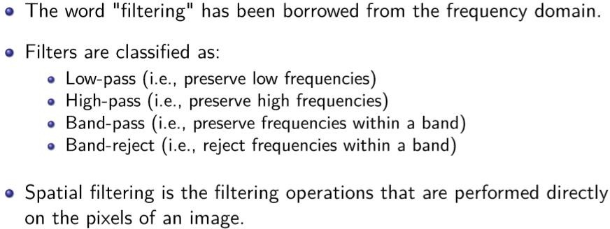
BASICS
3

Slide 4
SPATIAL FILTERING
Filtering – removing noise (unnecessary frequencies) –use filters
Spatial Filtering
Smoothening Filters – applying low pass filters
Smoothing- removed noise
Sharpening Filters – applying high pass filters
Sharpening- highlights edges
4

Slide 5
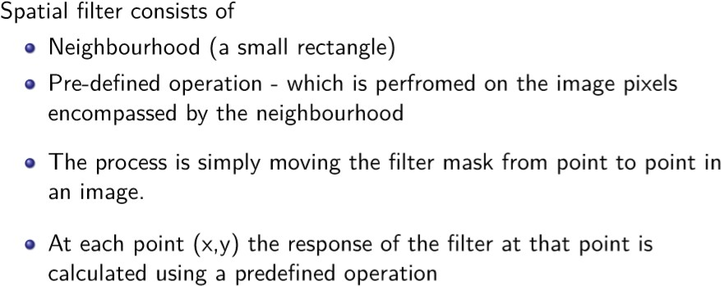
MECHANICS OF SPATIAL FILTERING
5

Slide 6
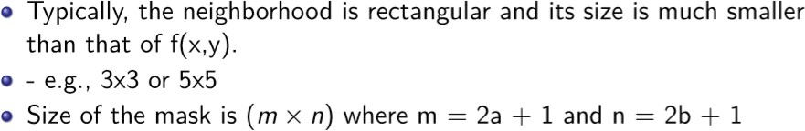
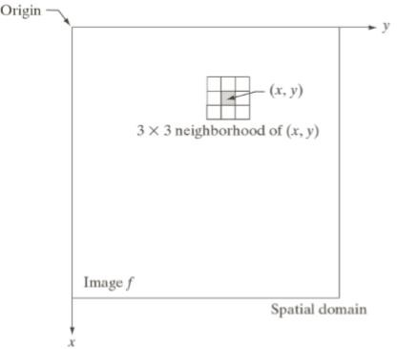
SPATIAL FILTERING (NEIGHBORHOOD OR MASK)
6

Slide 7
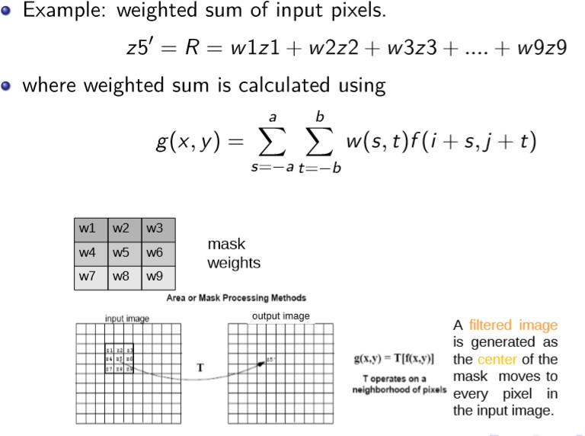
SPATIAL FILTERING- OPERATIONS
7

Slide 8
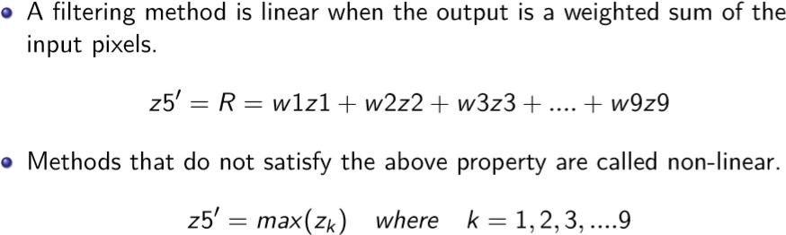
SMOOTHENING FILTERS- LINEAR VS NON LINEAR FILTERING
8

Slide 9
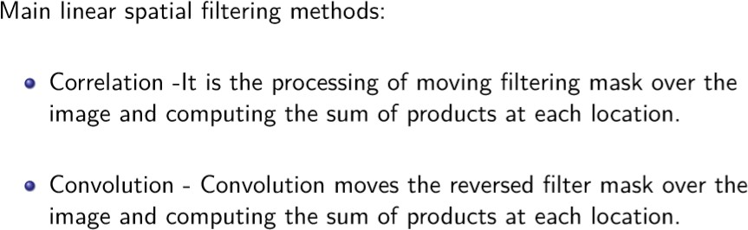
LINEAR SPATIAL FILTERING METHODS
9

Slide 10
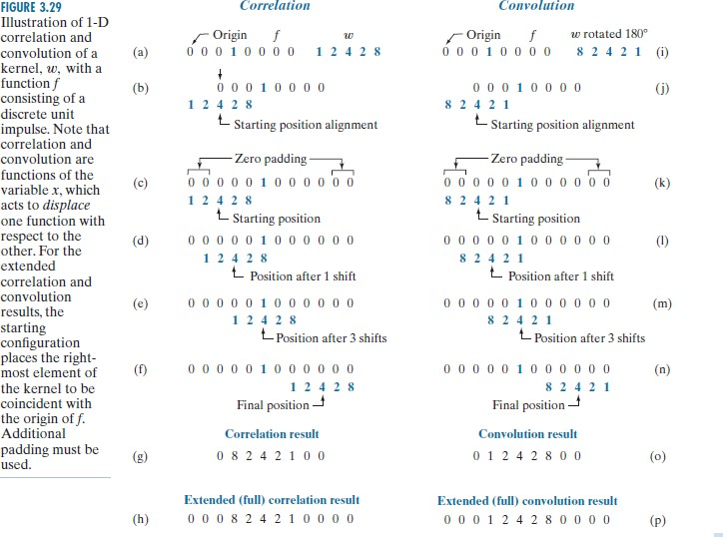
1- D CORRELATION AND CONVOLUTION
10

Slide 11
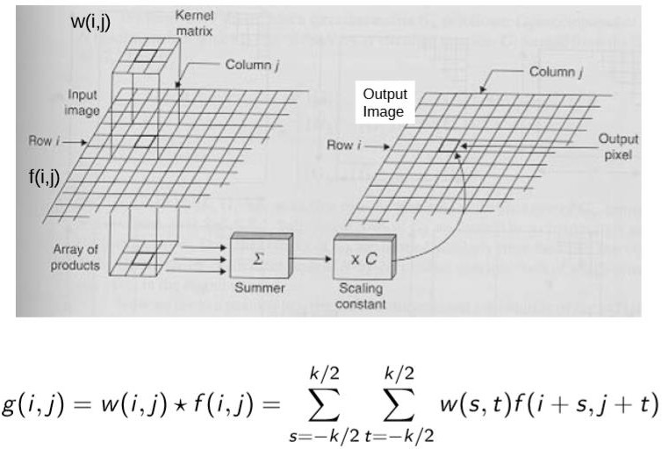
CORRELATION
11

Slide 12
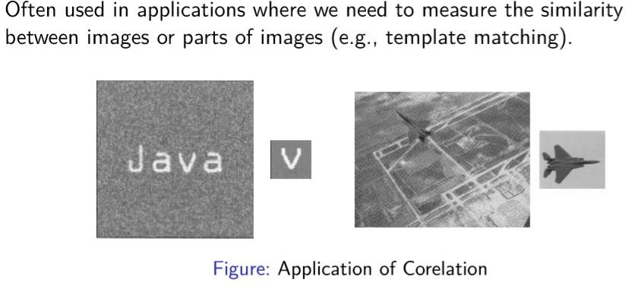
CORRELATION- APPLICATIONS
12

Slide 13
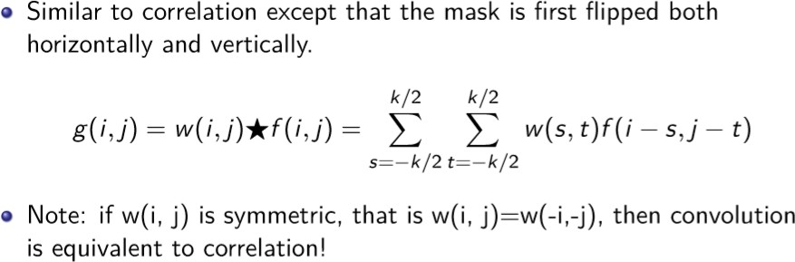
CONVOLUTION
13

Slide 14
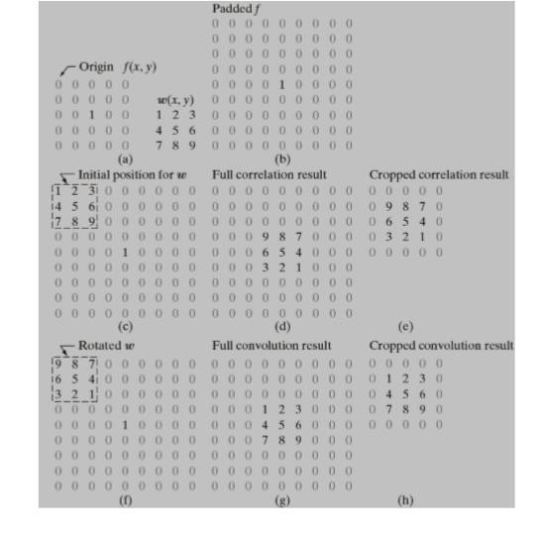
CORRELATION AND CONVOLUTION
14

Slide 15
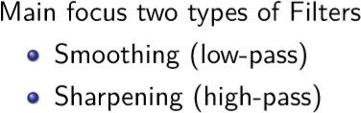
FILTERS
15

Slide 16
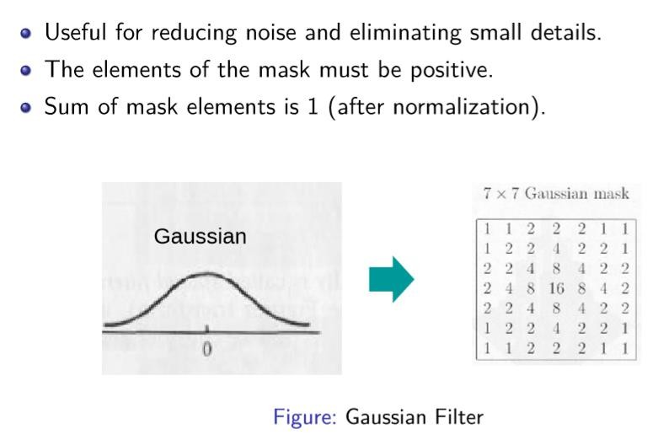
SMOOTHING FILTERS (LOW-PASS)
16

Slide 17
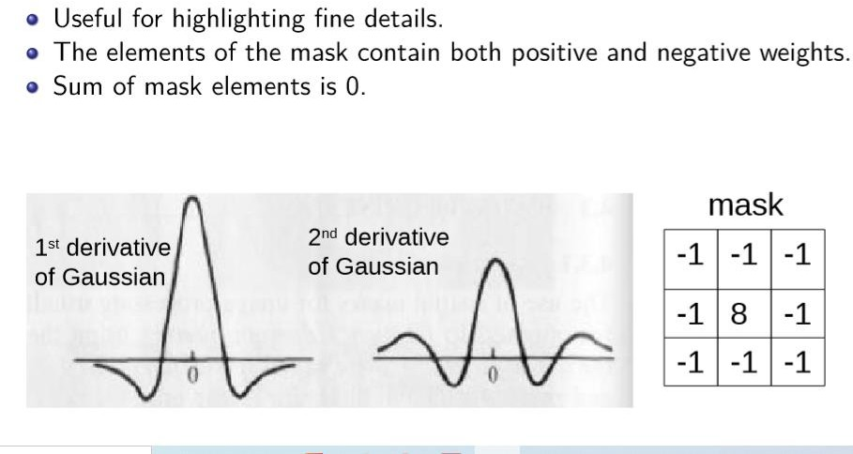
SHARPENING FILTERS(HIGH-PASS)
17

Slide 18
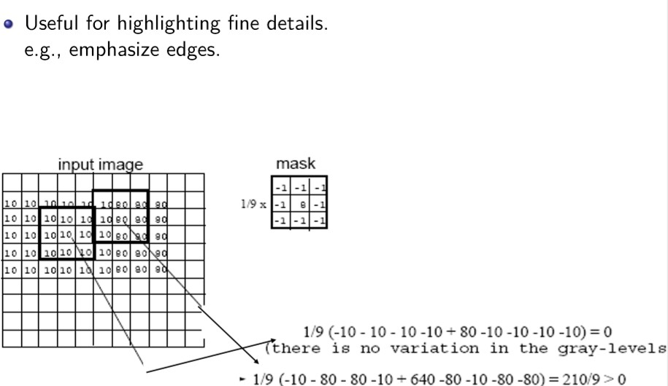
SHARPENING FILTERS(HIGH-PASS)
18

Slide 19
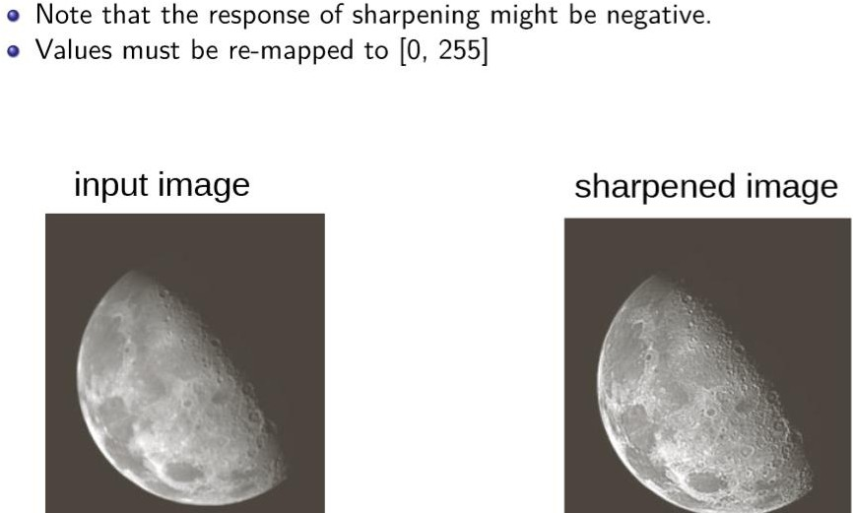
SHARPENING FILTERS(HIGH-PASS)
19

Slide 20
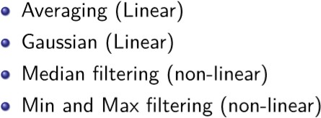
SMOOTHING FILTERS
20

Slide 21
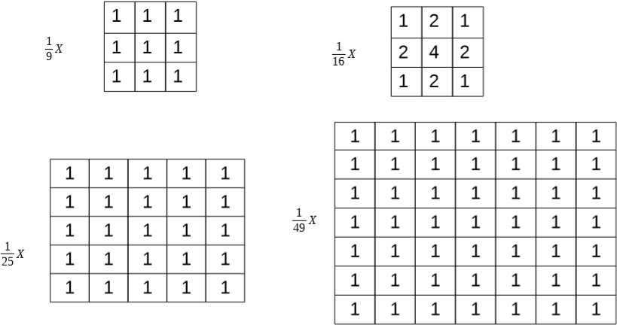
SMOOTHING FILTERS- AVERAGING(LINEAR)
21

Slide 22
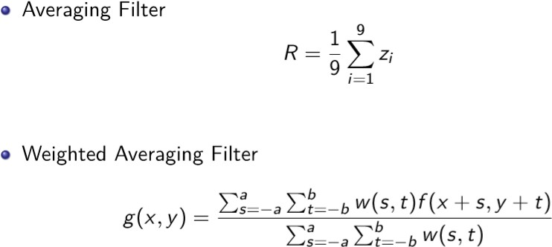
SMOOTHING FILTERS- AVERAGING
24

Slide 23
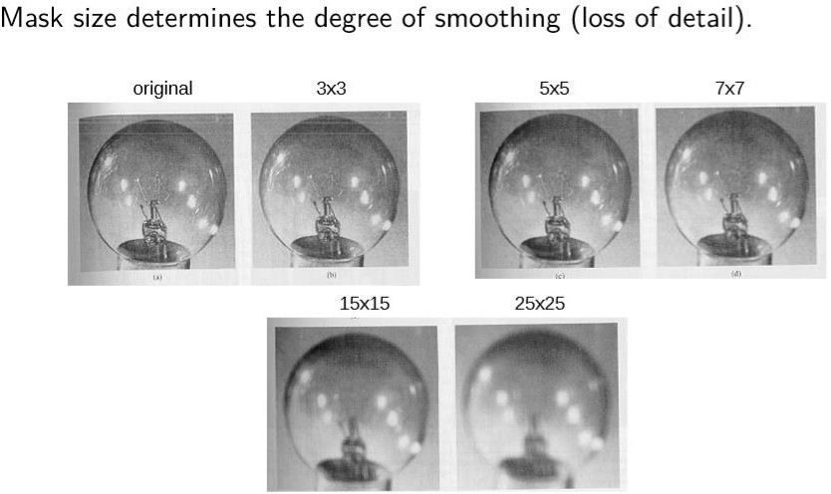
SMOOTHING FILTERS- AVERAGING
25

Slide 24
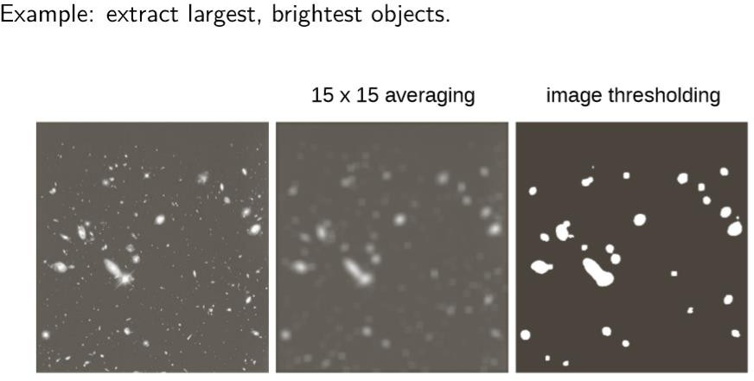
SMOOTHING FILTERS- AVERAGING
26

Slide 25
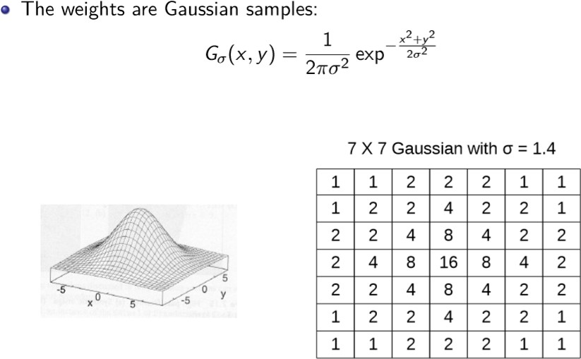
SMOOTHING FILTERING- GAUSSIAN
27

Slide 26
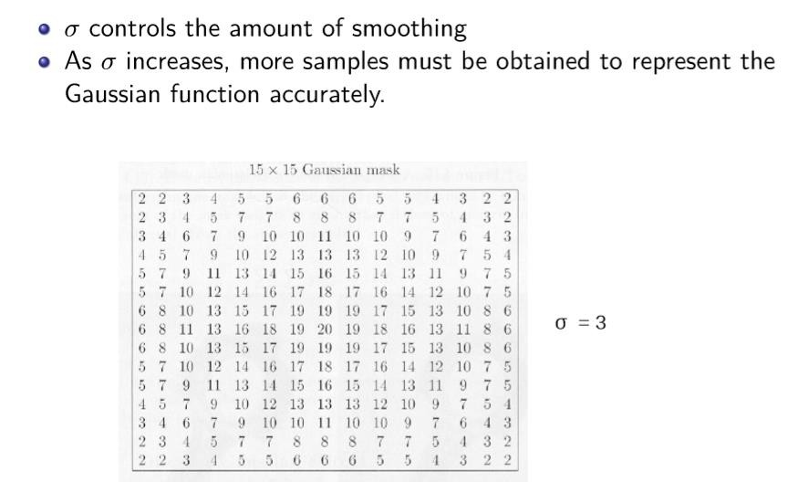
SMOOTHING FILTERING-GAUSSIAN
28

Slide 27
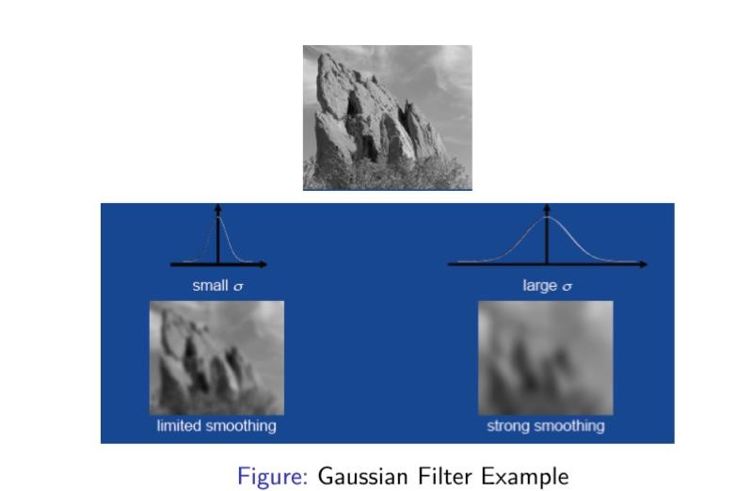
SMOOTHING FILTERING- GAUSSIAN
29

Slide 28
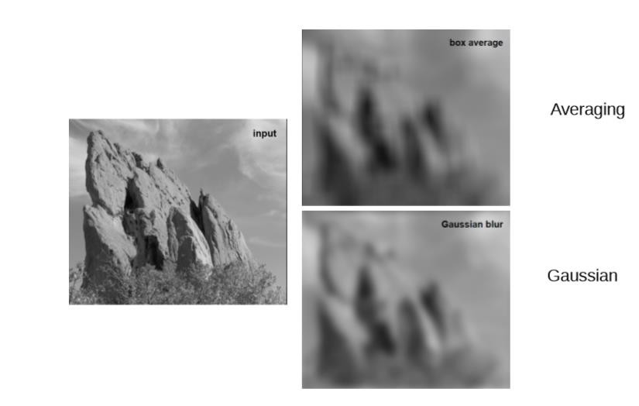
AVERAGE VS GAUSSIAN FILTER
30

Slide 29
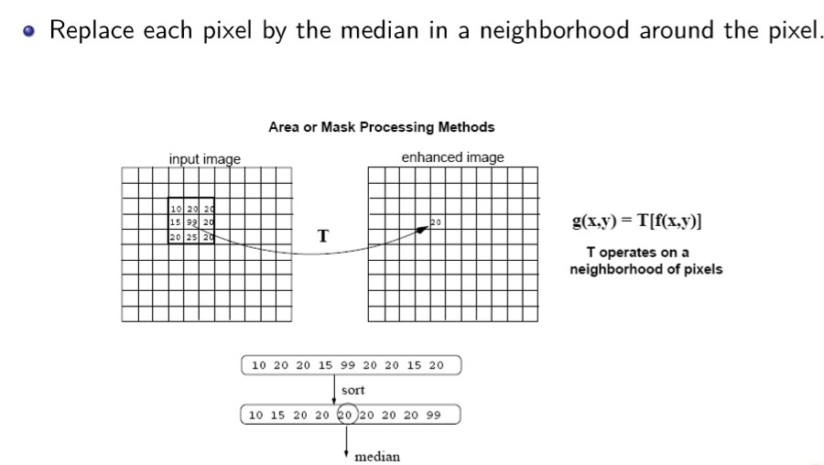
SMOOTHING FILTERS: MEDIAN FILTERING (NON LINEAR)
31

Slide 30
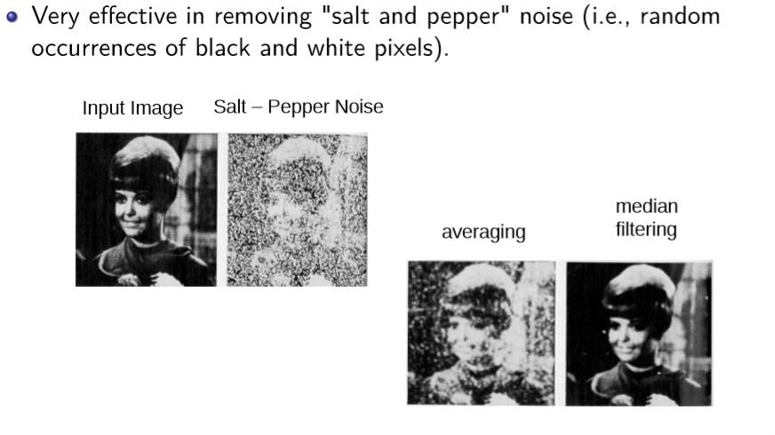
SMOOTHING FILTERS: MEDIAN FILTERING (NON LINEAR)
32

Slide 31
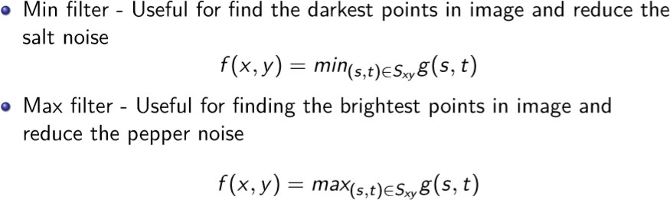
SMOOTHING FILTERS: MIN AND MAX FILTERING (NON LINEAR)
33

Slide 32
THANK YOU
34

